Slide 1
Lead Nurturing Infographics
01
02
03
04
05
Here is where this template begins
06

Slide 2
Lead Nurturing Infographics
01
02
Identify target
Align content
Mercury is the closest planet to the Sun
Despite being red, Mars is a cold place
03
04
Identify timing
Buil, launch & test
Jupiter is the biggest planet of them all
Earth is the third planet from the Sun

Slide 3
Lead Nurturing Infographics
Inform
01
The lead nurturing funnel
02
Educate
Venus has a very beautiful name, but also an extremely poisonous atmosphere
Involve
03
04
Validate
Convert
05
06
Maintain
Mercury
Mercury is the closest planet to the Sun

Slide 4
Lead Nurturing Infographics
6 types of lead nurturing campaigns
Mercury is the closest planet to the Sun and the smallest one of them all
Educational engagement
01
02
Product/service
Jupiter is a gas giant and the biggest planet
Neptune is the farthest planet from the Sun
Promotional
03
04
Event engagement
Saturn is a gas giant and has several rings
Despite being red, Mars is a cold place
Re-engagement
05
06
Competitor
Venus is the second planet from the Sun
Pluto is considered a dwarf planet

Slide 5
Lead Nurturing Infographics
Lead
Pluto is now a dwarf planet
Educate
Inform
Engage
Convert
Mercury is the smallest planet
Jupiter is the biggest planet
Venus has a beautiful name
Saturn is the ringed planet

Slide 6
Lead Nurturing Infographics
01
02
Email marketing
Phone calls
Mercury is the closest planet to the Sun
Despite being red, Mars is a cold place
4
Lead nurturing effective strategies
03
04
Social media
Remarketing
Jupiter is the biggest planet of them all
Earth is the third planet from the Sun

Slide 7
Lead Nurturing Infographics
Conversion
Scoring
Nurturing
Fidelization
Mercury is the closest planet to the Sun and the smallest one in the entire Solar System
Visit
Customer

Slide 8
Lead Nurturing Infographics
Characteristics of user interaction
Similarity with the buyer persona
Actual purchase process phase
Interactions with the brand
Venus has a very beautiful name, but also an extremely poisonous atmosphere
Jupiter is a huge gas giant named after the Roman god of the skies and the lightning
Earth is the third planet from the Sun and the only one that harbors life in the Solar System

Slide 9
Lead Nurturing Infographics
Articles
Social media
Grow customers
Acquire
Activate
Outreach
Updates
Keep customers
Events
Contests
Email
Blog
Viral loop
Up-sell
Get customers
Next-sell
Cross-sell
Referrals

Slide 10
Lead Nurturing Infographics
TOF
Top of funnel
Cold audience
01
Neptune is the farthest planet from the Sun
MOF
Middle of funnel
Warm audience
02
Despite being red, Mars is a cold place
BOF
Bottom of funnel
Hot audience
03
Pluto is considered a dwarf planet

Slide 11
Lead Nurturing Infographics
5 best practices for effective lead nurturing
01
Personalize
Neptune is the farthest planet from the Sun
02
Educate according to journey
Jupiter is a gas giant and the biggest planet
03
Don’t email leads every day
Mercury is the closest planet to the Sun
04
Don’t send every lead every mail
Venus is the second planet from the Sun
05
Start now
Earth is the third planet from the Sun

Slide 12
Lead Nurturing Infographics
01
06
Inform
Maintain
Jupiter is a gas giant and the biggest planet
Neptune is the farthest planet from the Sun
Lead nurturing process
02
05
Educate
Convert
Mercury is the closest planet to the Sun
Despite being red, Mars is a cold place
03
04
Involve
Validate
Venus is the second planet from the Sun
Pluto is considered a dwarf planet

Slide 13
Lead Nurturing Infographics
Lead nurturing program example
Sign up
Act
2nd email
Not engage
Attends webinar
1st email
Download
Mercury is the closest planet to the Sun and the smallest one in the entire Solar System
Not engage
2nd email
Not engage

Slide 14
Lead Nurturing Infographics
01
03
Attract
Close
Blog
Keywords
Social media
Emails
Signals
Workflow
Strangers
Visitors
Leads
Customers
Promoters
Forms
CTA’s
Landing
Events
Social
Content
Convert
Delight
02
04

Slide 15
Lead Nurturing Infographics
Companies that excel at
Lead nurturing workflows
Lead nurturing
Why lead nurturing?
Generate
50%
Efficiency
More leads at
Jupiter is a gas giant and the biggest planet
30%
Qualified leads
Credibility
Lower cost

Slide 16
Lead Nurturing Infographics
TOFU
MOFU
BOFU
Leads
Prospects
Opportunities
Lead
Generation
Nurturing

Slide 17
Lead Nurturing Infographics
01
Filter MQLs
Mercury is the closest planet to the Sun
The benefits of lead nurturing
02
Personalization
Despite being red, Mars is a cold place
03
Automated workflows
Jupiter is the biggest planet of them all
04
Multichannel strategy
Earth is the third planet from the Sun

Slide 18
Lead Nurturing Infographics
Marketing automation
Audience segments
Nurturing campaigns
01
02
03
04
New leads
Warm leads
Opportunities
Customers
Visual
Posts
White papers
Events
Demos
Reviews
Webinar
Guides
Sales proposal
Special offers
Special pricing
Buyer guides
Information
Training
Updates
News

Slide 19
Lead Nurturing Infographics
Segment
Personalize
Schedule
Mercury is the closest planet to the Sun
Jupiter is a gas giant and the biggest planet
Venus is the second planet from the Sun
70%
60%
50%
Experiment
Lead nurturing
Automate
Earth is the third planet from the Sun
Despite being red, Mars is a cold place
50%
70%

Slide 20
Lead Nurturing Infographics
Appropriate content at each stage in the buyer’s journey
Awareness
Consideration
Decision
Ads
Checklists
Infographics
Landing pages
Videos
Blog posts
Case studies
E-books
Social media
Webinars
Questionnaires
Ratings
Reviews
Self-assessments
Offers

Slide 21
Lead Nurturing Infographics
The power of automation
Mercury is the closest planet to the Sun and the smallest one in the entire Solar System
Lead nurturing best-practice checklist
 | Use client data
 | Understand audience
 | Appropriate goals
 | Keep it personal
 | Perfect timing
 | Test and optimize
 | Lead scoring
 | Cater for all devices
 | Relevant content

Slide 22
Lead Nurturing Infographics
Get customers
Grow customers
Outreach programs
Product updates
Social media
Keep customers
Media
Acquire
Activate
Up-sell
Next-sell
Cross-sell
Referrals
Contests, events
Articles
Blogs, emails
Loyalty programs

Slide 23
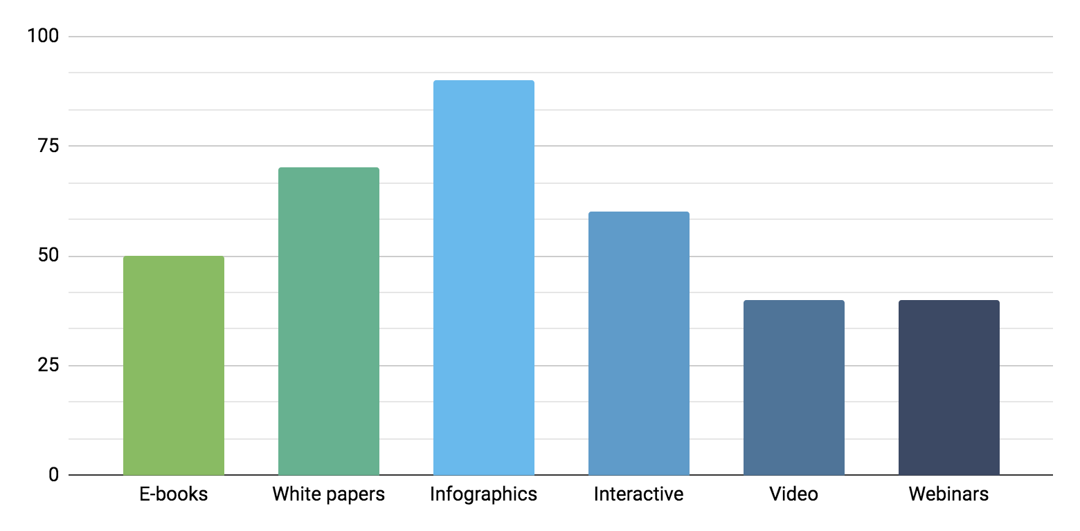
Lead Nurturing Infographics
Lead nurturing best tactics
Saturn is a gas giant and has several rings. It's composed mostly of hydrogen and also helium
Success rate
+ 60%
50%
70%
90%
60%
40%
40%
Follow the link in the graph to modify its data and then paste the new one here. For more info, click here

Slide 24
Lead Nurturing Infographics
Tech partners
Trade shows
Magazine ads
Direct mail
Lead nurturing activities
Earth is the third planet from the Sun and the only one that harbors life in the Solar System
Conferences
Nurturing
Database
Programs

Slide 25
Lead Nurturing Infographics
Sales lifecycle
Neptune
Neptune is the farthest planet from the Sun
Marketing
Find more leads
Mars
Sales
Despite being red, Mars is a cold place
Win more deals
Accounts
Retain and grow
Pluto
Pluto is considered a dwarf planet

Slide 26
Lead Nurturing Infographics
Lead nurturing process
Day 1 | Intro phone call | Intro email | LinkedIn connection
Day 5 | Nurture email #1 | 2nd phone call | Mail letter
Day 9 | 3rd phone call |  | Nurture email #2
Day 13 | 4th phone call |  | CTA email
Day 17 | 5th phone call | Email break up | Review

Slide 27
Lead Nurturing Infographics
Educate
Inform
Engage
Convert
30%
20%
40%
10%
Earth is the third planet from the Sun
Mercury is the closest planet to the Sun
Jupiter is the biggest planet of them all
Despite being red, Mars is a very cold place

Slide 28
Lead Nurturing Infographics
Lead nurturing
Leads
Customers
Attract
Cross-selling
Up-selling
Mercury is the smallest planet of them all
Jupiter is the biggest planet of them all
Despite being red, Mars is actually a very cold place

Slide 29
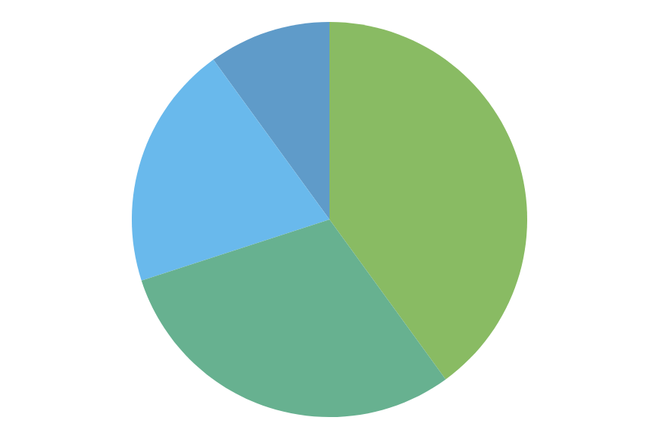
Lead Nurturing Infographics
10%
40%
Identify target
Align content
Mercury is the closest planet to the Sun
Despite being red, Mars is a cold place
20%
30%
Identify timing
Buil, launch & test
Jupiter is the biggest planet of them all
Earth is the third planet from the Sun
Follow the link in the graph to modify its data and then paste the new one here. For more info, click here

Slide 30
Lead Nurturing Infographics
Qualified leads
Opportunities
Strategy
Nurture
Qualify
Content
Events
Score
Route
Engage
Propose
Demand
Lead nurturing
Sales
Interactive
Response
Report
Automate
Lost
Negotiate

Slide 31
Lead Nurturing Infographics
Educate
Inform
Mercury is the smallest planet
Jupiter is the biggest planet
Lead nurturing
Engage
Convert
Venus has a beautiful name
Saturn is the ringed planet

Slide 32
Lead Nurturing Infographics
Lead nurturing example
Website form
No engagement
Re-engagement
Venus has a beautiful name and is the second planet from the Sun. It has very high temperatures
Send email
Engagement
Customized email

Slide 33
Instructions for use (premium users)
If you are a Premium user on Slidesgo, you can use this template without attributing Slidesgo.
You are allowed to:
Modify this template.
Use it for both personal and commercial purposes.
Hide or delete the “Thanks” slide and the mention to Slidesgo in the credits.
Share this template in an editable format with people who are not part of your team.
You are not allowed to:
Sublicense, sell or rent this Slidesgo Template (or a modified version of this Slidesgo Template).
Distribute this Slidesgo Template (or a modified version of this Slidesgo Template) or include it in a database or in any other product or service that offers downloadable images, icons or presentations that may be subject to distribution or resale.
Use any of the elements that are part of this Slidesgo Template in an isolated and separated way from this Template.
Register any of the elements that are part of this template as a trademark or logo, or register it as a work in an intellectual property registry or similar.
For more information about editing slides, please read our FAQs or visit Slidesgo School:
https://slidesgo.com/faqs and https://slidesgo.com/slidesgo-school

Slide 34
Infographics
You can add and edit some infographics to your presentation to present your data in a visual way.
Choose your favourite infographic and insert it in your presentation using Ctrl C + Ctrl V or Cmd C + Cmd V in Mac.
Select one of the parts and ungroup it by right-clicking and choosing “Ungroup”.
Change the color by clicking on the paint bucket.
Then resize the element by clicking and dragging one of the square-shaped points of its bounding box (the cursor should look like a double-headed arrow). Remember to hold Shift while dragging to keep the proportions.
Group the elements again by selecting them, right-clicking and choosing “Group”.
Repeat the steps above with the other parts and when you’re done editing, copy the end result and paste it into your presentation.
Remember to choose the “Keep source formatting” option so that it keeps the design. For more info, please visit Slidesgo School.

